Slide 1


Presented By Group Member
ID | Name
0182310012101096 | Jubayda Sultana
0182310012101133 | Zannatul fardaus prome
0182310012101135 | Nilanta Roy Nilay
1932020013 | Md. Shazadur Rahman

Slide 2
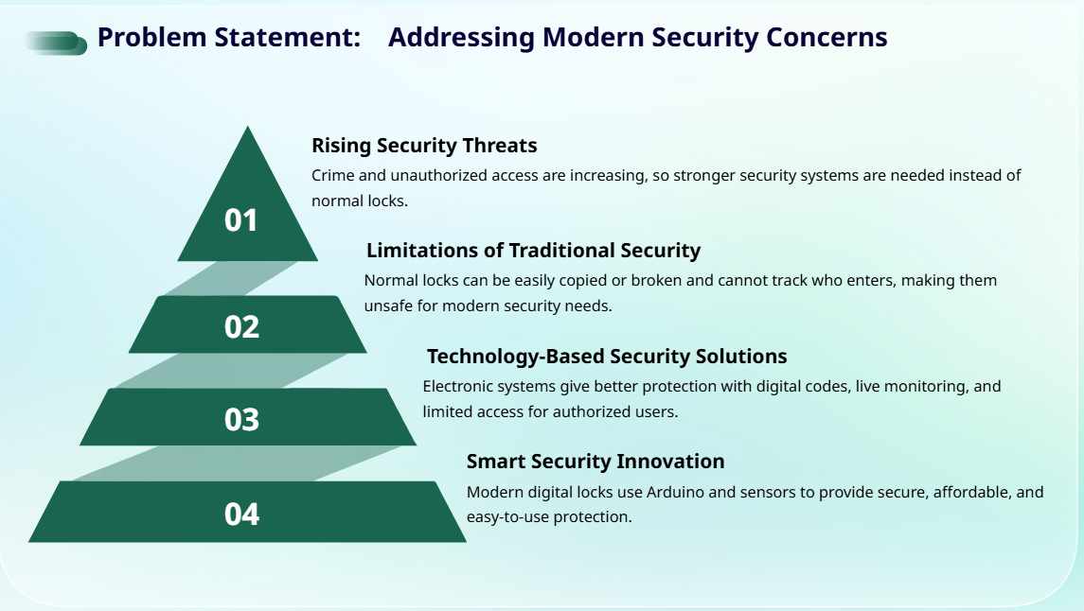

Slide 3
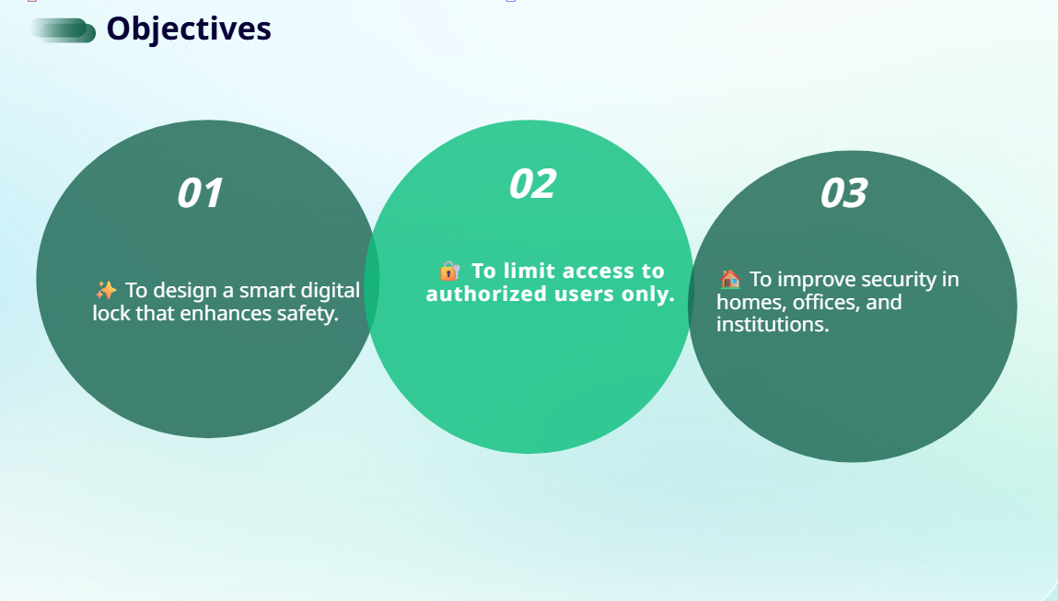

Slide 4
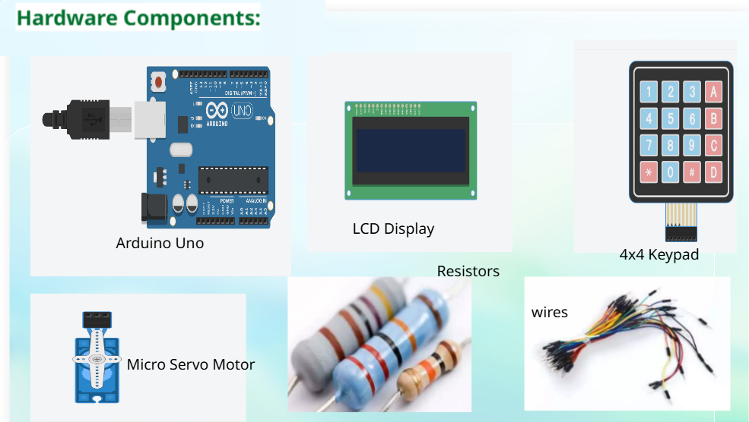

Slide 5
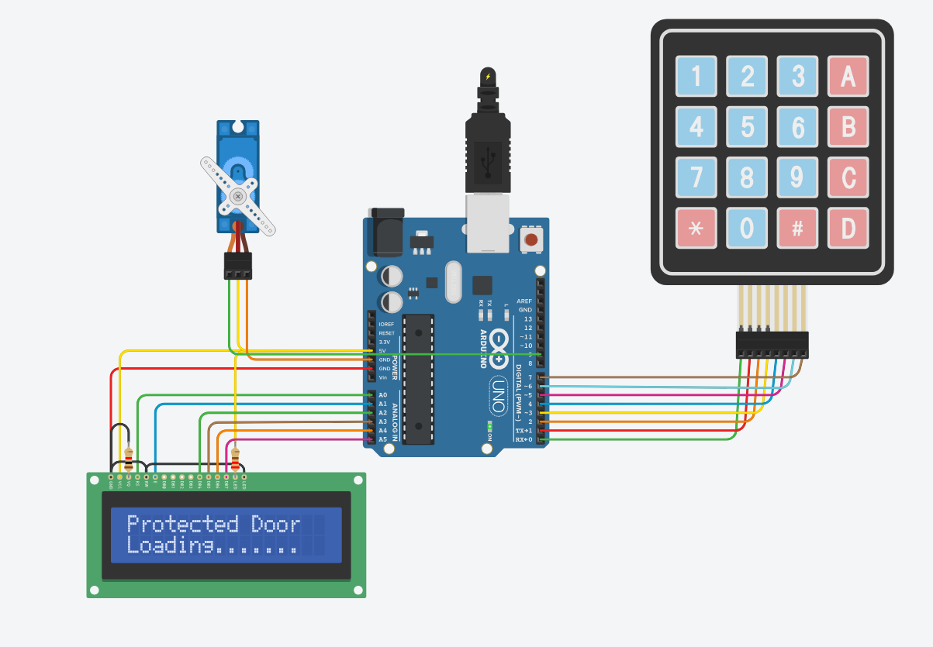
Connection:

Slide 6
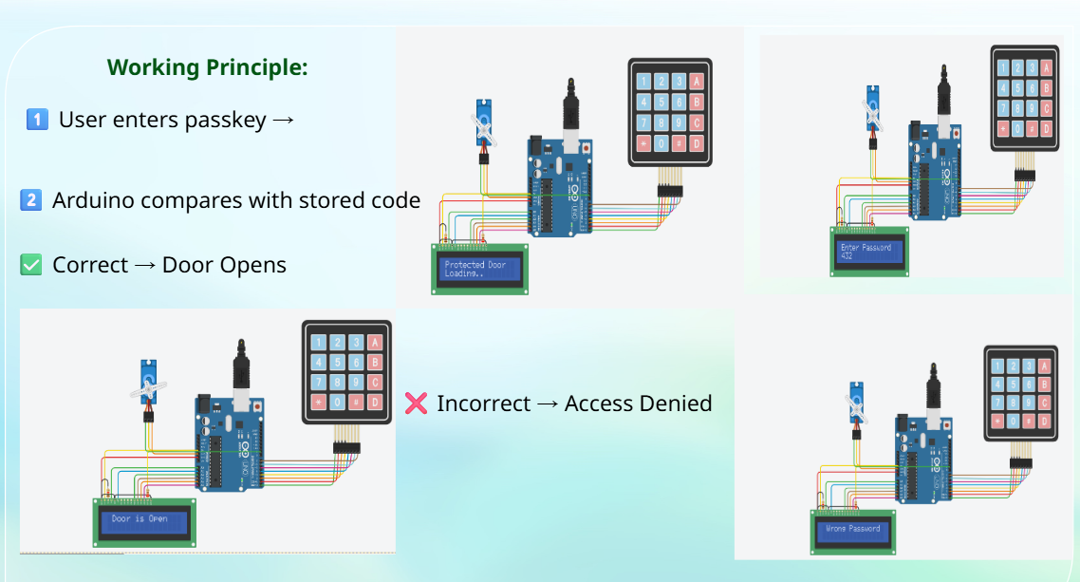

Slide 7
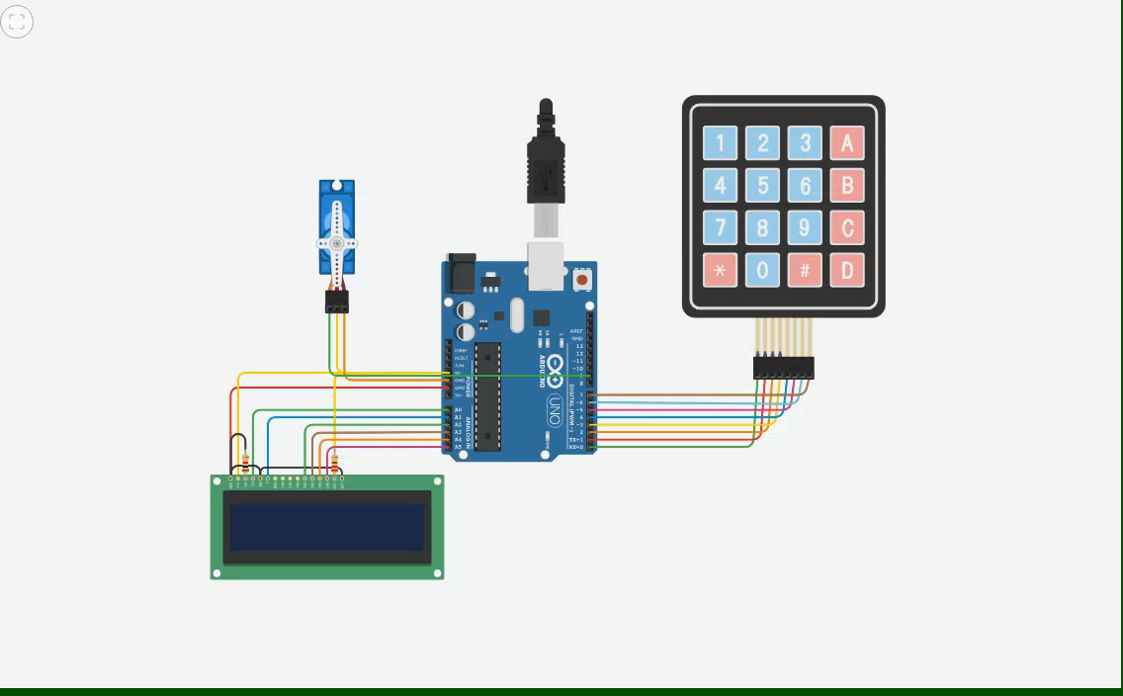

Slide 8
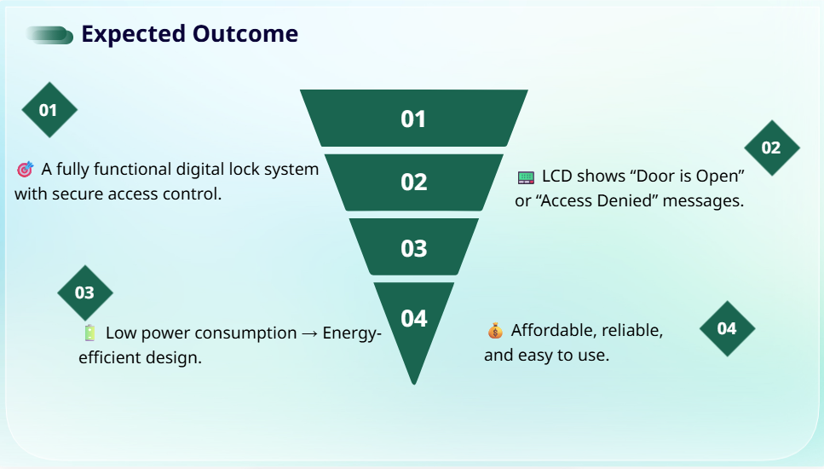

Slide 9
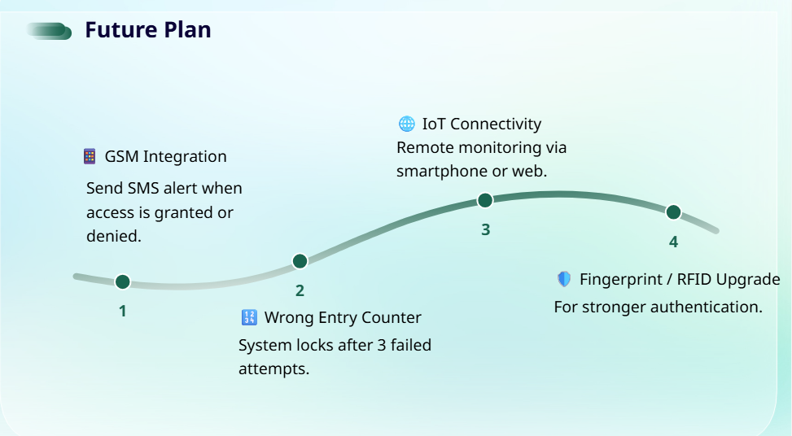

Slide 10
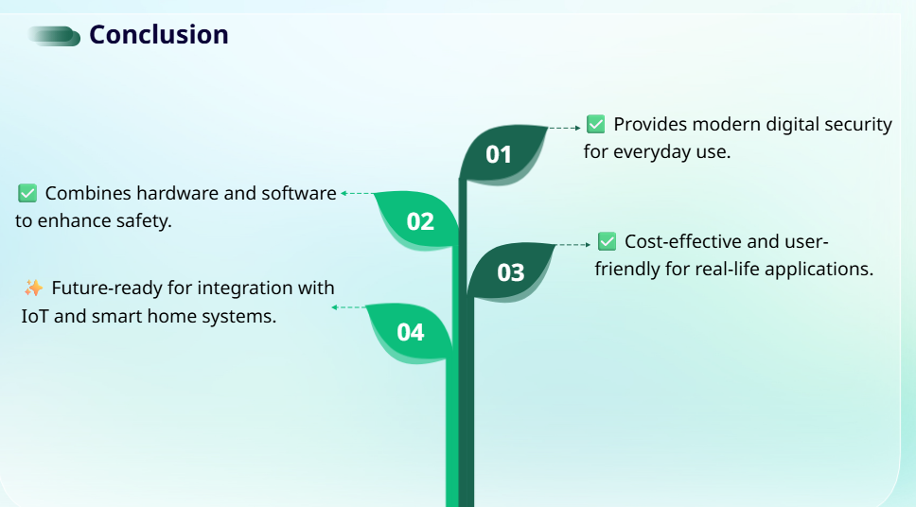

Slide 11


